Slide 1

Project Name: Data Analytics Capstone Project (Football Data Analytics)
Student Name : Akhil James Mentor Name : Jaya Pandey
Batch Name : DA30

Slide 2
Introduction:
Importance of Football Data Analysis: It highlights the role of analysing large datasets in understanding player success and making informed decisions for coaches, scouts, and analysts.
Process of Football Data Analysis: It explains the process as collecting, cleaning, and analysing data to extract valuable insights.
Benefits of Football Data Analysis: The text mentions how these insights can improve player performance, team tactics, fan engagement, and overall decision-making.
Data Analysis Techniques: It briefly mentions tools like Python, MySQL, Excel, and Tableau.
Overall Goal: The text concludes by emphasizing how these insights can enhance decision-making, improve team performance, and provide a competitive edge.

Slide 3
Data Description
1 | date_x | Date of the game appearance
2 | player_name_x | Player name
3 | Competition id | Unique identifier for a competition
4 | yellow_cards | Number of yellow cards received by the player in the game
5 | red_cards | Number of red cards received by the player in the game
6 | goals | Number of goals scored by the player in the game
7 | assists | Number of assists provided by the player in the game
8 | minutes_played | Number of minutes played by the player in the game
9 | name | Player's full name (may not be unique)
10 | current_club_id | Unique identifier for the player's current club
11 | country_of_birth | Player's country of birth
12 | date_of_birth | Player's date of birth
13 | position_x | Primary position of the player on the field
14 | foot | Player's preferred foot (e.g., "Right", "Left")
15 | height_in_cm | Player's height in centimeters
16 | market_value_in_eur | Estimated market value of the player in Euros
17 | highest_market_value_in_eur | Highest recorded market value of the player in Euros
18 | contract_expiration_date | Date the player's contract expires (optional)
19 | agent_name | Player's agent name (optional)
20 | type_x (optional) | Type of game event (e.g., "Goal", "Yellow Card")
21 | description (optional) | Description of the game event
22 | season | Season in which the game was played
23 | date | Date of the game (may differ from date_x for rescheduled matches)
24 | home_club_goals | Number of goals scored by the home team
25 | away_club_goals | Number of goals scored by the away team
26 | home_club_position | League position of the home team at the time of the game (optional)
27 | away_club_position | League position of the away team at the time of the game (optional)
28 | home_club_manager_name | Name of the home team manager (optional)
29 | away_club_manager_name | Name of the away team manager (optional)
30 | stadium | Stadium where the game was played
31 | attendance | Number of attendees at the game (optional)

Slide 4
Business Focus Area :
Performance Analysis
Player Profile and Market Value
Team Comparison
Attendance and Stadium Analysis
Referee Analysis
Substitution Patterns
Event Analysis
Competition Analysis
Player Attributes and Demographics
Contract Management

Slide 5
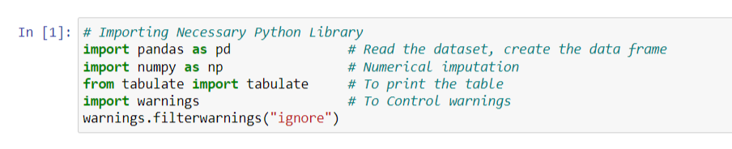
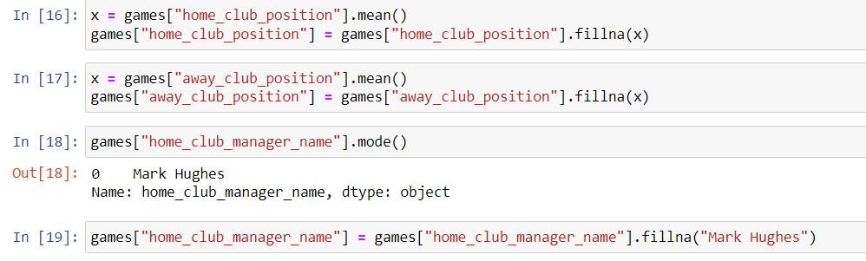
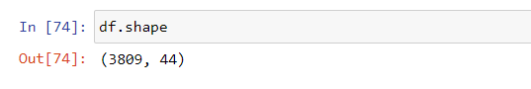
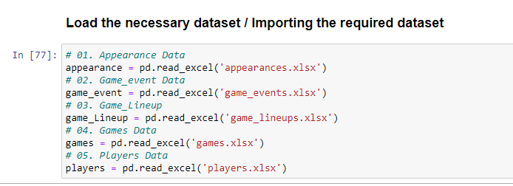
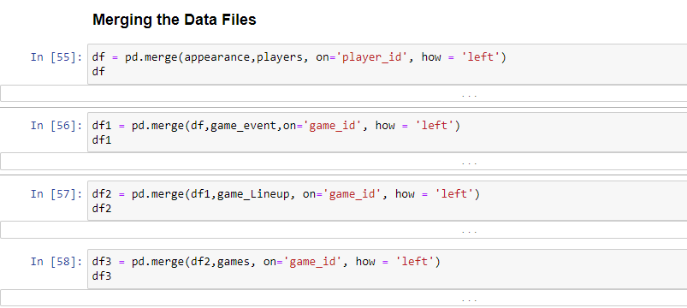
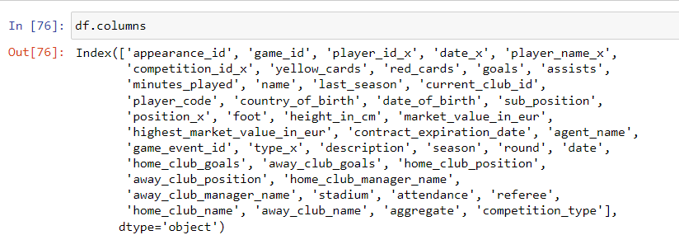
Sprint 1: Data Cleaning and Data Preprocessing
Importing the necessary libraries
Treating missing values / null values
Checking the shape
Loading / Reading the data set
Merging all the data files
Displaying the names of all columns

Slide 6
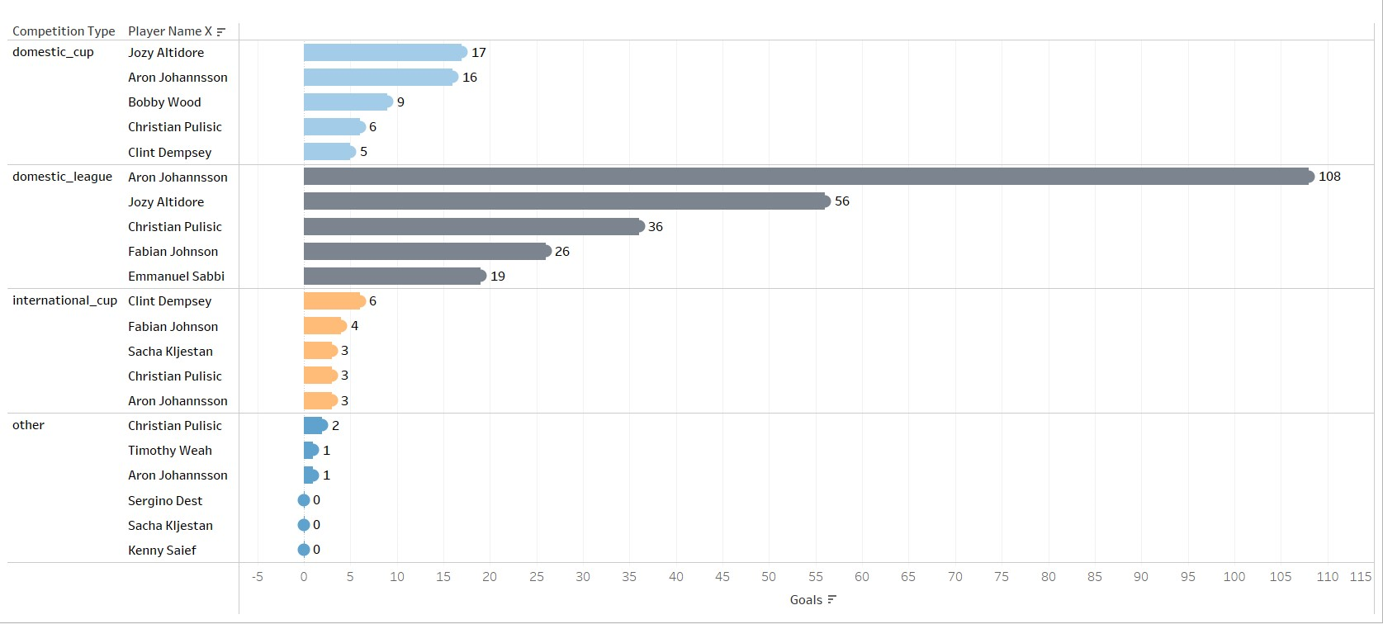
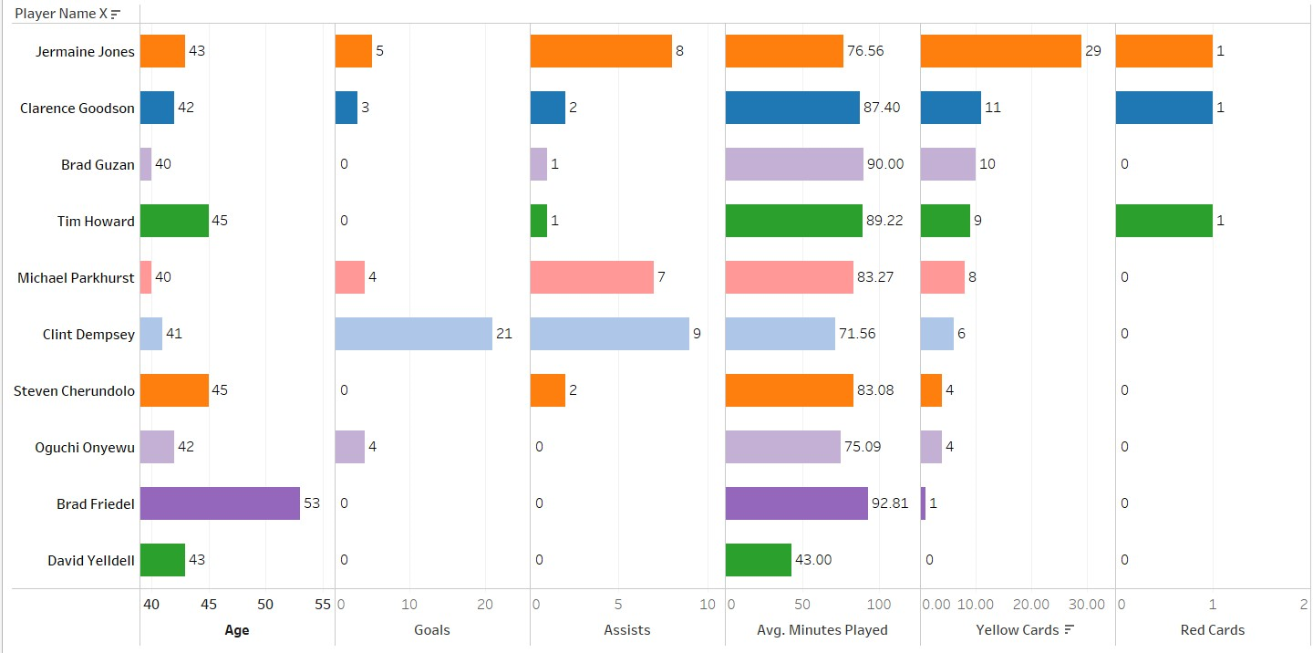
Performance Analysis
Objective 01:
Identifying prolific goal scorers
Objective 02:
Player Evaluation
Interpretation:
This chart allows you to easily identify the top 5 scorers for each competition-season by looking at the tallest bars within each group.
Interpretation:
You can see if positions with higher yellow cards also have higher or lower goals/assists. This might indicate a trade-off between aggressive play and offensive/defensive contribution

Slide 7
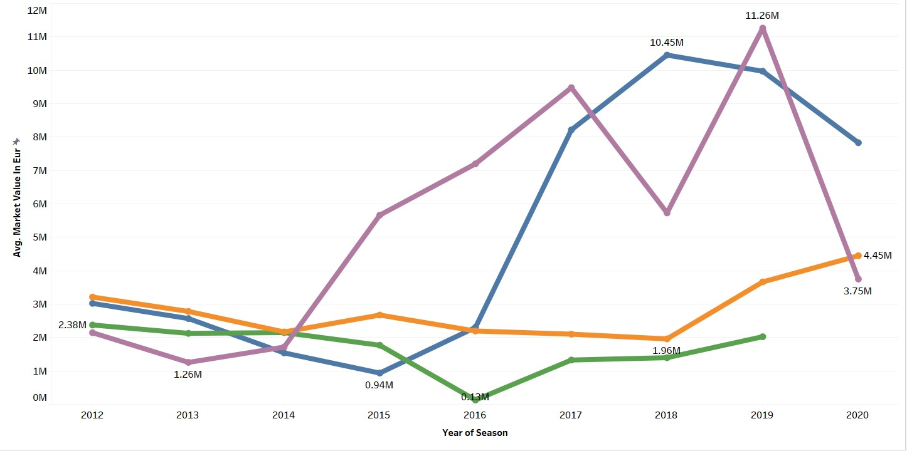
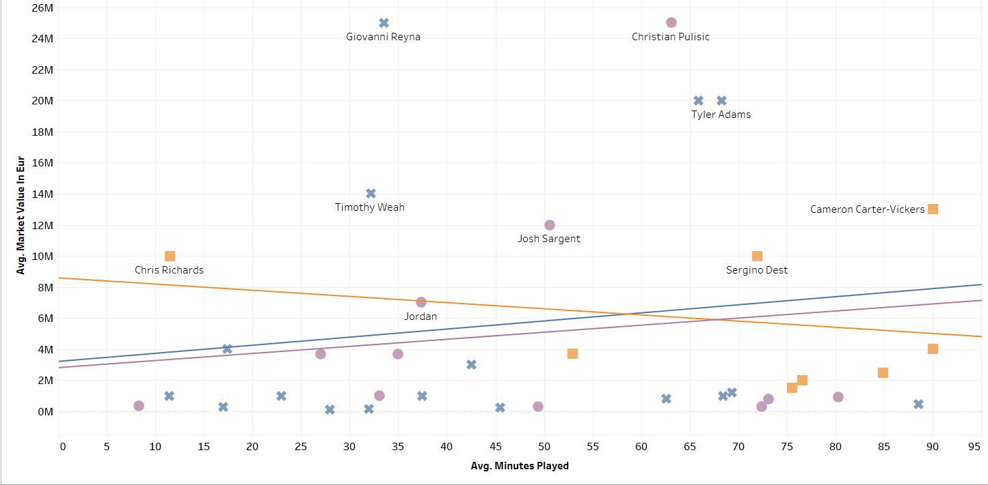
Player Profile and Market Value
Objective 01:
Identifying Market Trends
Objective 02:
Identifying Market Expectations
Interpretation:
you can gain insights into market trends for specific player positions. You can identify positions that are becoming increasingly valuable or those where market value might be stagnating. This information can be valuable for clubs when scouting players, negotiating transfers, and planning their overall strategy
Interpretation:
Just because players with higher market value tend to play more minutes doesn't necessarily mean that playing more minutes increases a player's market value. Other factors like talent, performance, and potential also play a role.

Slide 8
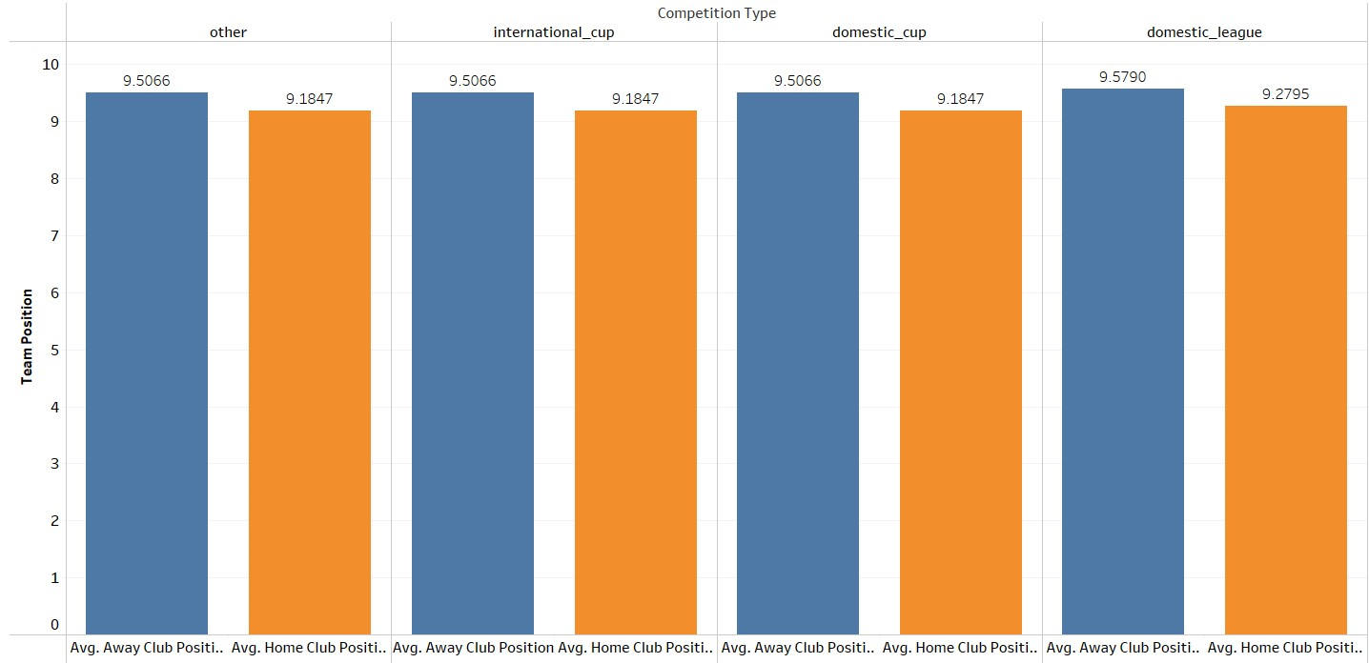
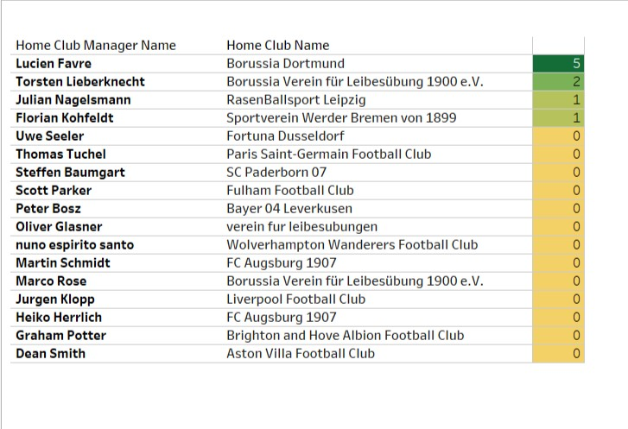
Team Comparison
Objective 01:
Managerial Evaluation
Objective 02:
Strategic Decision Making
Interpretation:
Here you can identify managers who seem to have a positive impact on young player development. This information can be valuable for clubs when scouting managers or making decisions about player development strategies.
Interpretation:
you can gain insights into how the home advantage varies depending on the league or competition type. This information can be valuable for coaches when preparing game strategies and for analysts when assessing team performance.

Slide 9
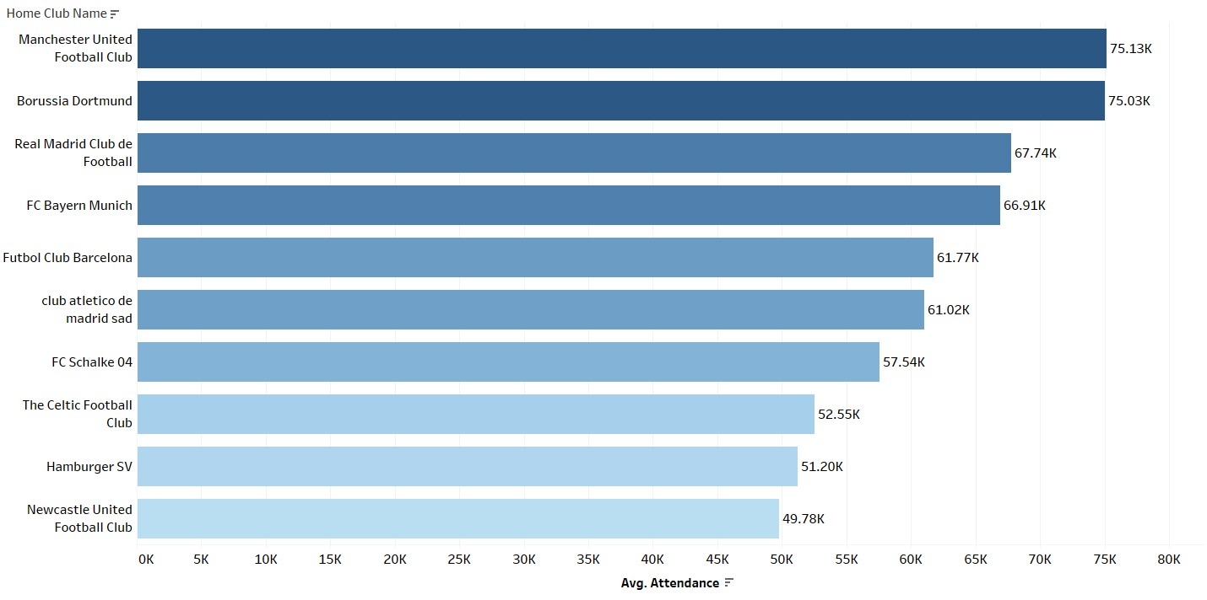
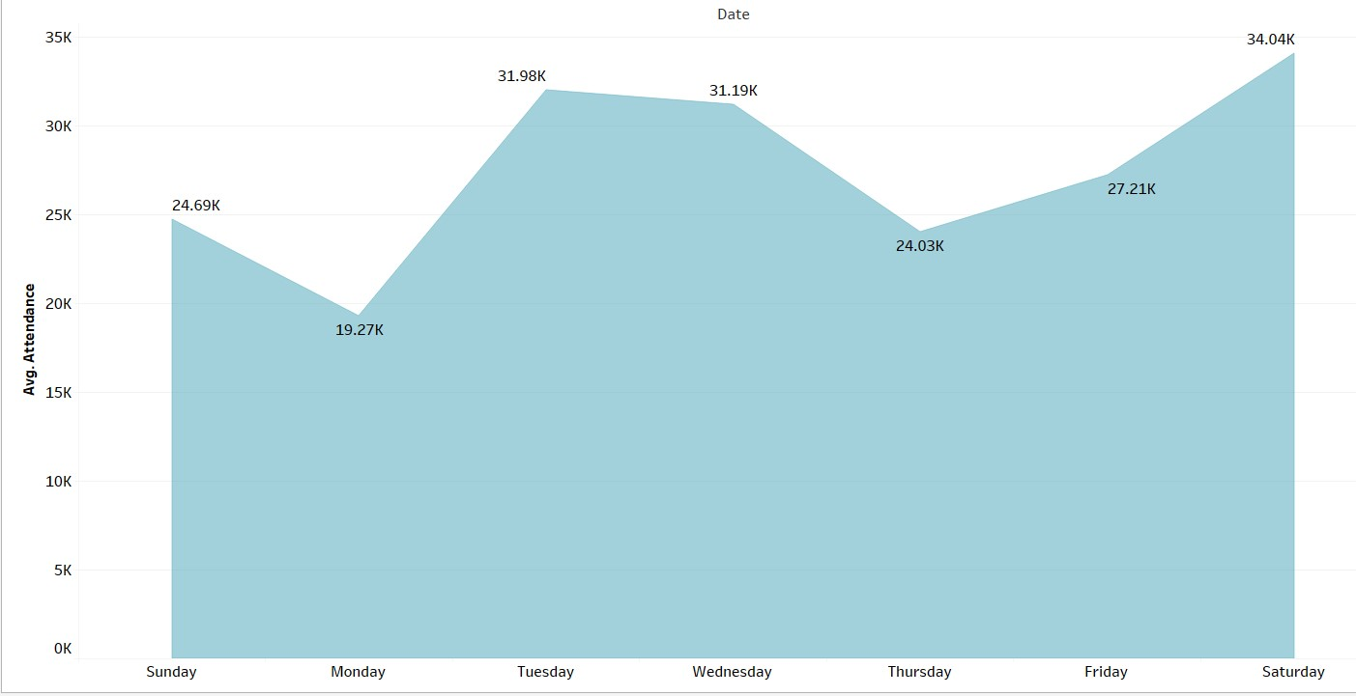
Attendance and Stadium Analysis
Objective 01:
Identifying Trends
Objective 02:
Scheduling Strategies
Interpretation:
By analysing the top teams or clubs with the highest average attendance you gain valuable insights into fan engagement team popularity and factors influencing attendance. This knowledge can be used by teams leaves and Stadium operators to develop strategies to attract more fans and hands to all match day experience.
Interpretation:
By analysing this data, you can gain insights into attendance patterns based on weekdays vs. weekends. This information can be valuable for teams when scheduling games, setting ticket prices, or planning promotional activities.

Slide 10
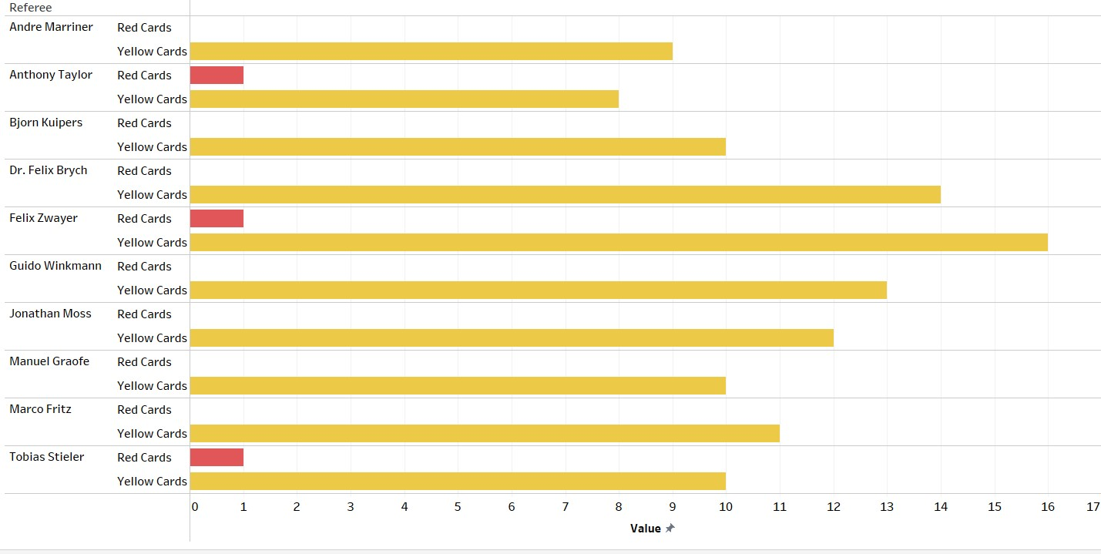
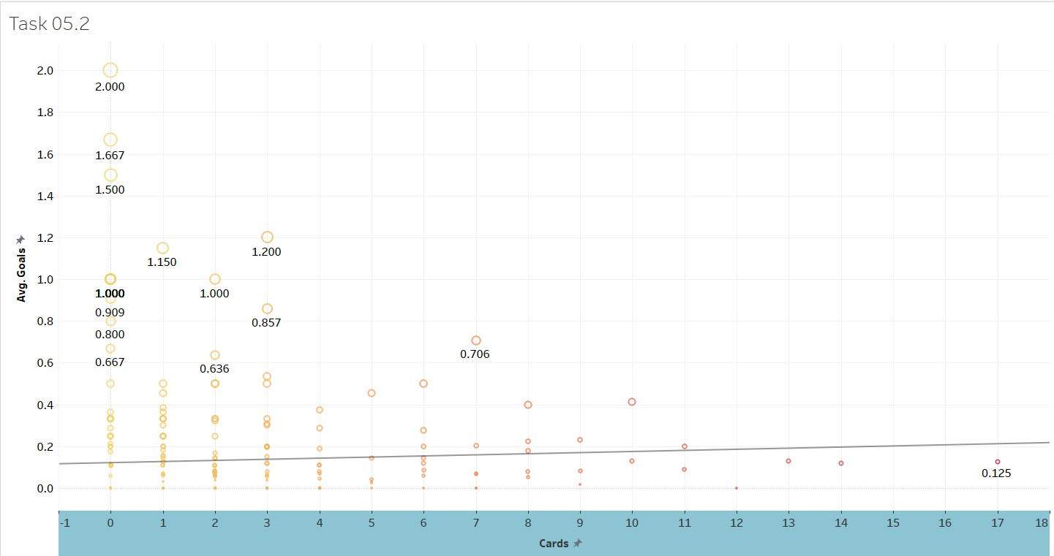
Referee Analysis
Objective 01:
Understanding Refereeing Styles
Objective 02:
Understanding Refereeing Impact
Interpretation:
By identifying referees who issue the most cuts you gain insights into their approach to card discipline this knowledge can be valuable for teams preparing for matches with specific reference analyse studying referring trends and potentially for leagues
Interpretation:
By analysing this data, you can explore potential relationships between refereeing style (card issuance) and goal scoring patterns. This information can be valuable for analysts studying officiating tendencies and match flow. . This would suggest that referees who tend to show more cards also oversee games with higher average goal scoring

Slide 11
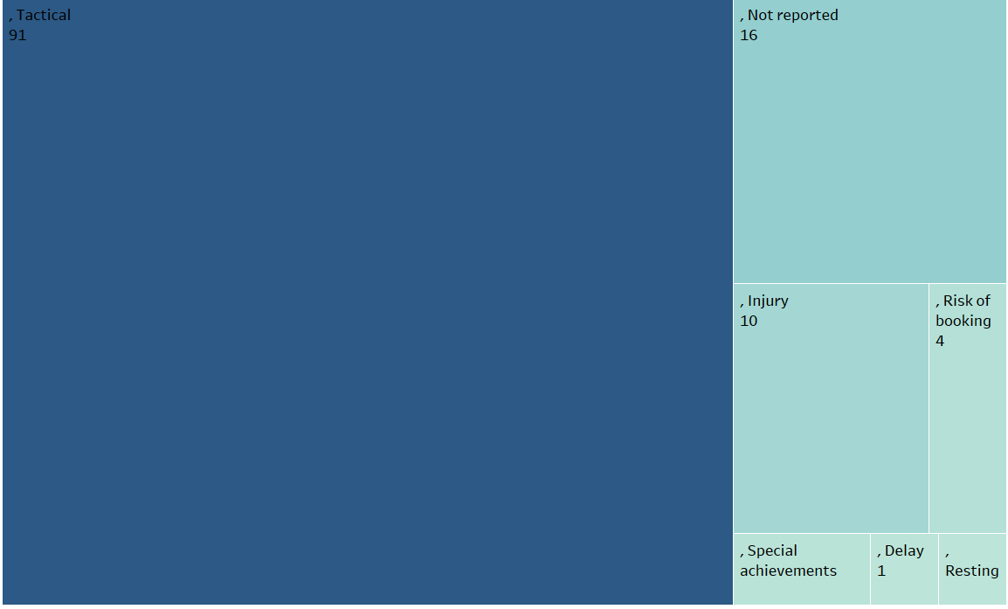
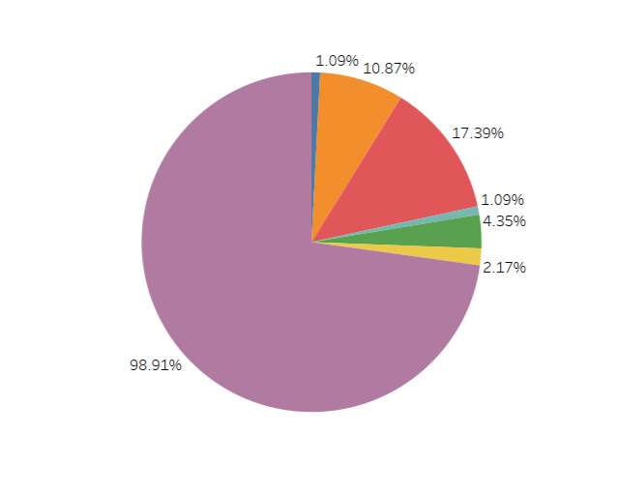
Substitution Patterns
Objective 01:
Understanding Substitution Strategies
Objective 02:
Maintaining Tactical Balance
Interpretation:
This information can be valuable for coaches when making substitution decisions and for analysts studying player performance.
Interpretation:
Substituting a player with someone who plays a similar role helps maintain the team's tactical formation and playing style. For example, if a central midfielder gets tired, the coach might bring on another central midfielder to keep the midfield presence strong.

Slide 12
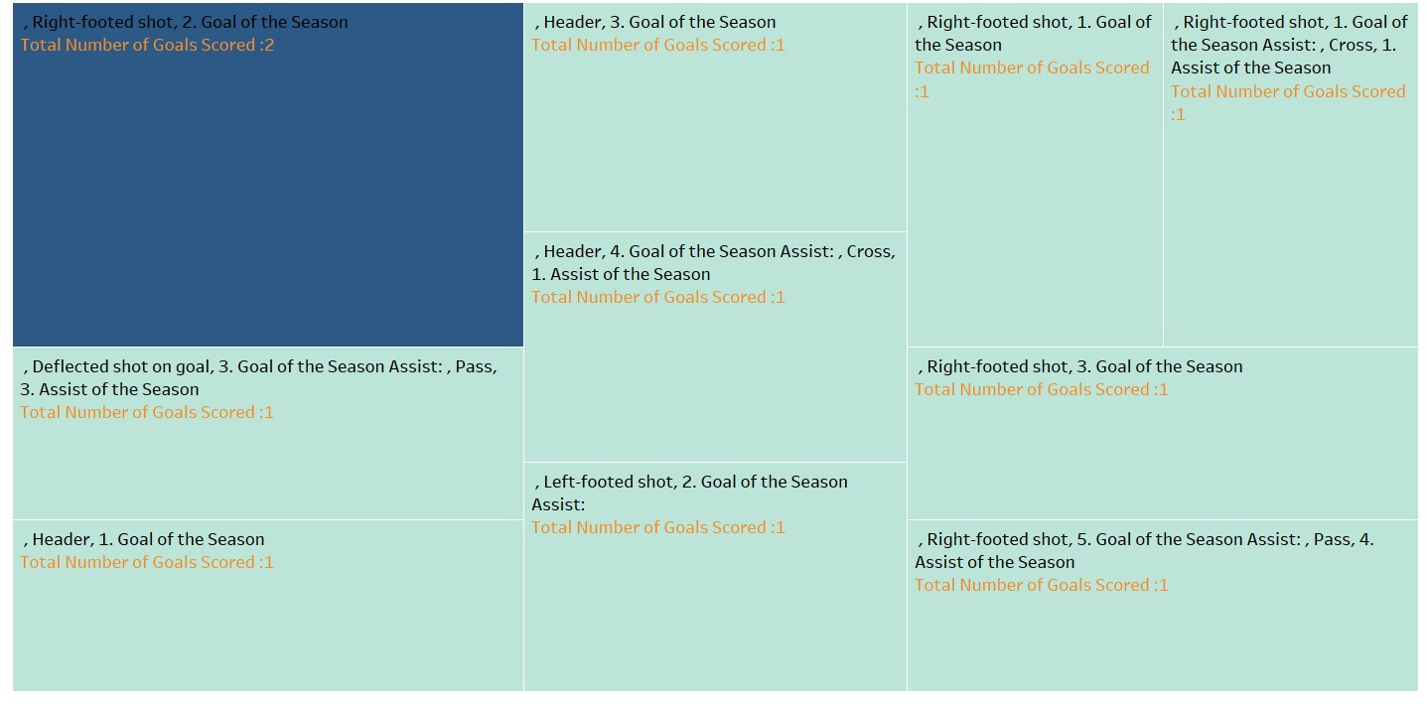
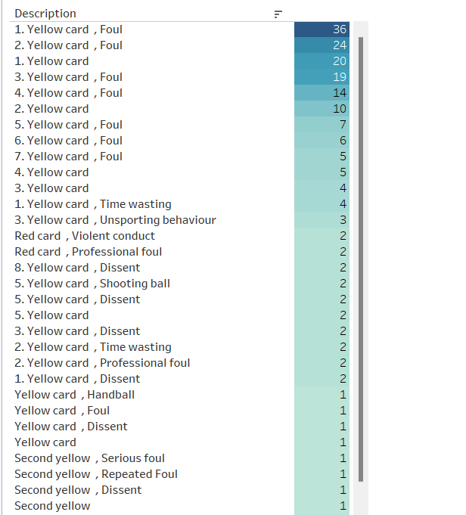
Event Analysis
Objective 01:
Identifying Strengths and Weaknesses
Objective 02:
Identify patterns in player behavior
Interpretation:
By understanding how players of different positions typically score coaches can identify areas to improve for instance midfielders who lack goal scoring might need to practice finishing with their weaker foot
Interpretation:
Analyze if players who are more prone to getting carded early in a match are more likely to repeat the behavior later.

Slide 13
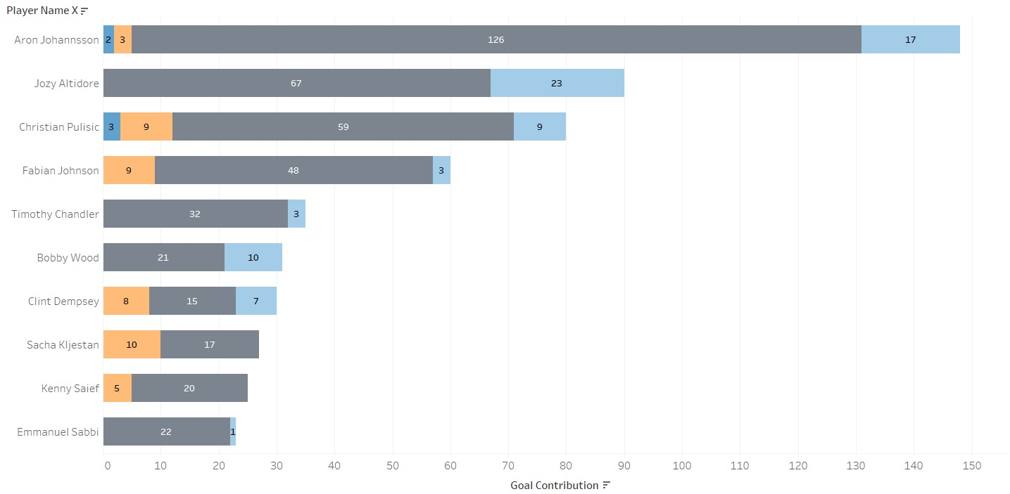
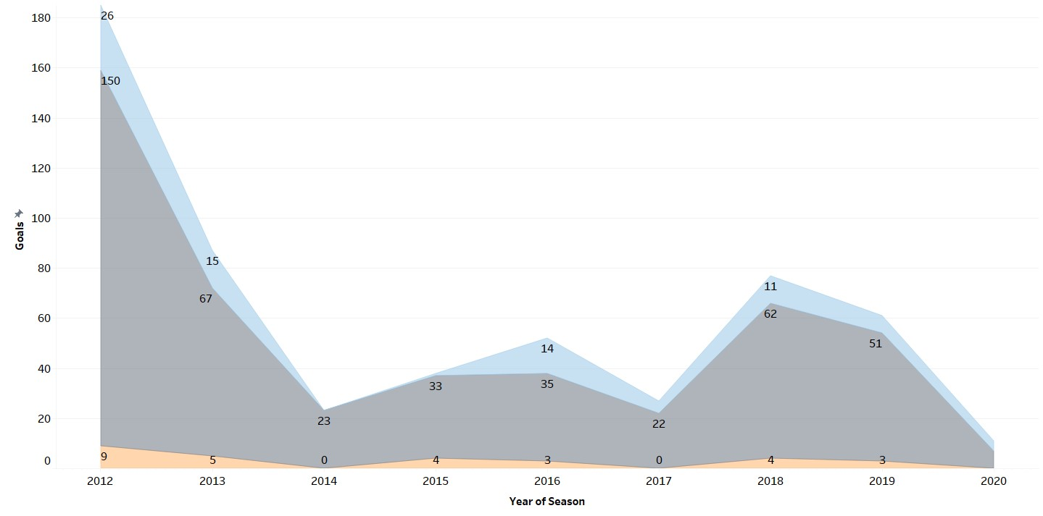
Competition Analysis
Objective 01:
Effect of Competition Type on Performance
Objective 02:
Comparison by Competition
Interpretation:
By analysing this chart, here you can gain insights into the players who scores in which competition. Just because players scores more / performances best in domestic league its not they play only in these matches. No, these competitions have more fixtures.
Interpretation:
Here you can see if the goals scored per season tend to change differently across these competitions over time. For instance, the goals scored in the league might be steadily increasing over several seasons, while cup competitions might show a fluctuating trend.

Slide 14
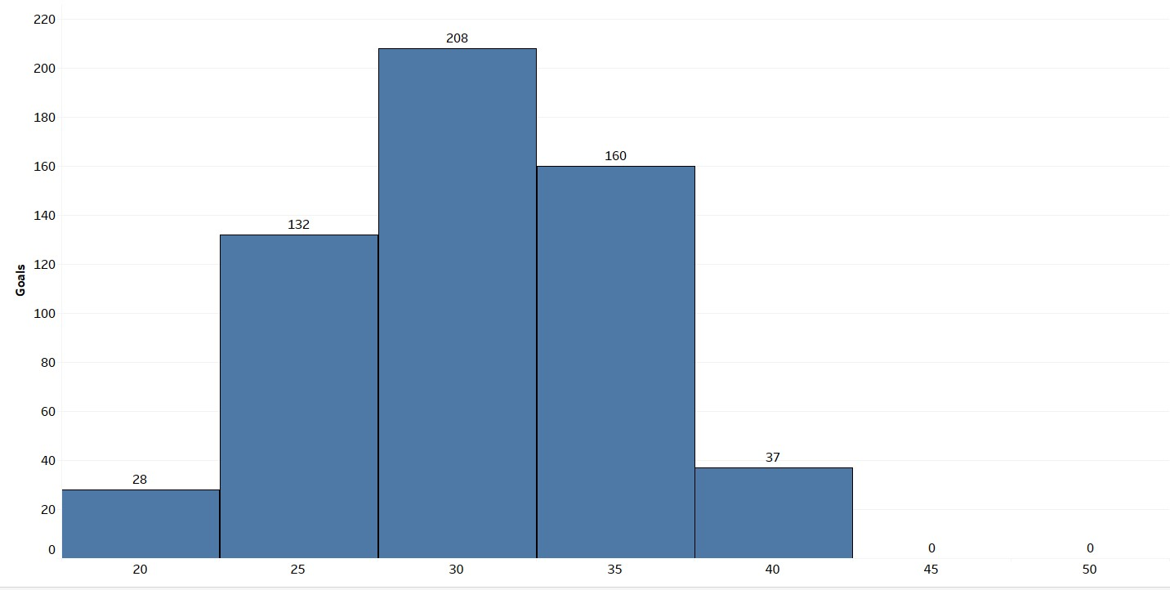
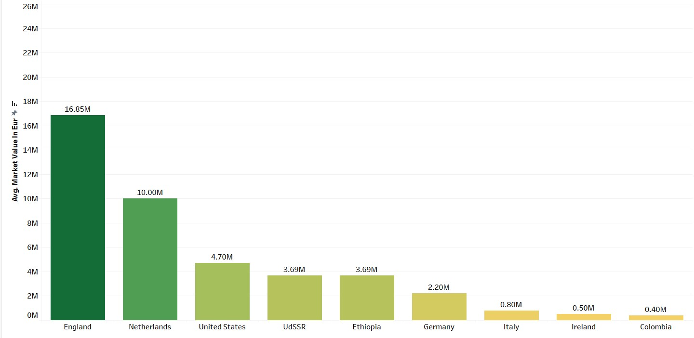
Player Attributes and Demographics
Objective 01:
Understanding Peak Performance
Objective 02:
Demographic Trends in Player Market Value
Interpretation:
By analysing this data, you can explore potential links between player age and goal-scoring performance. This information can be valuable for coaches looking at player development strategies and for analysts studying player performance trends.
Interpretation:
By analysing this data, you can explore potential trends in market value based on a player's nationality. This information can be valuable for analysts scouting players in different regions and for fans interested in player valuation trends across countries

Slide 15
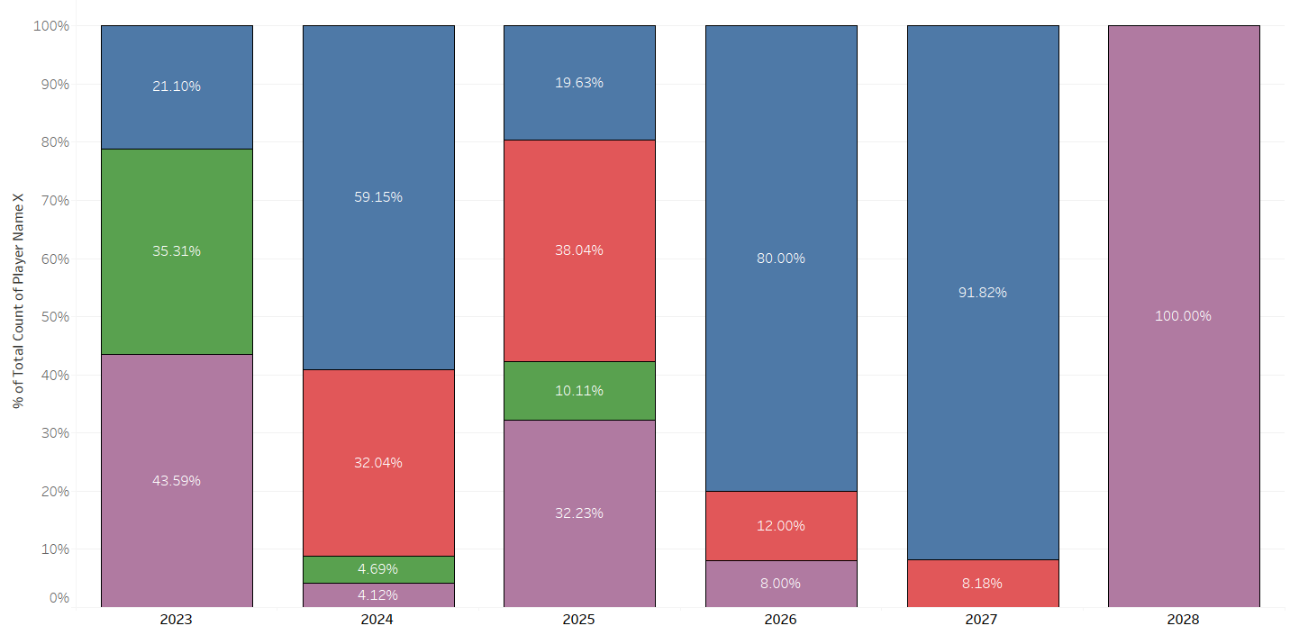
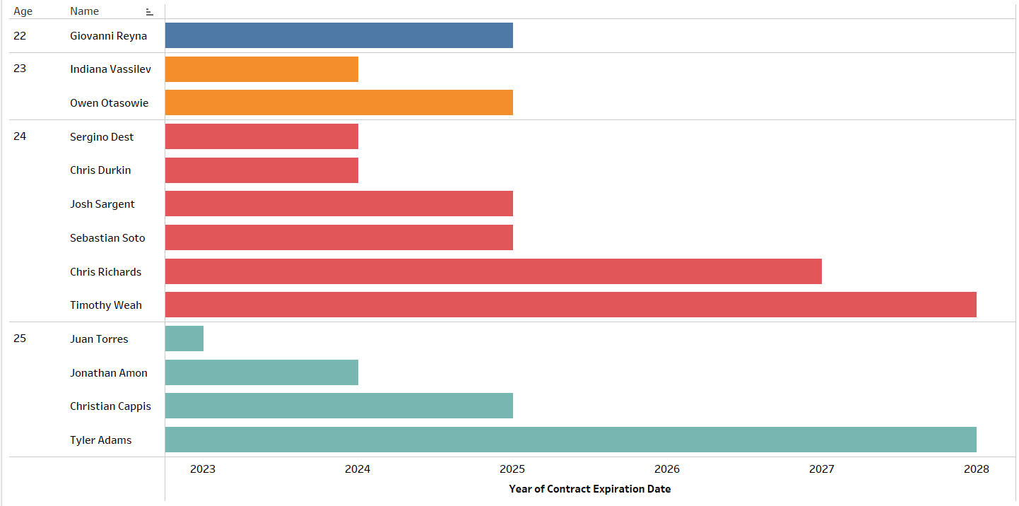
Contract Management
Objective 01:
Prioritizing Contract Renewals
Objective 02:
Strategic Contract Offers
Interpretation:
By analysing this data, Here we are able to get insight information that in which year the most number of free agents are available and also in which position.
Interpretation:
By analyzing this question, you can gain insights into a potential relationship between player age and contract strategy. This knowledge can be valuable for contract management decisions. Such as Identifying players whose contracts are expiring soon, especially younger key players.

Slide 16
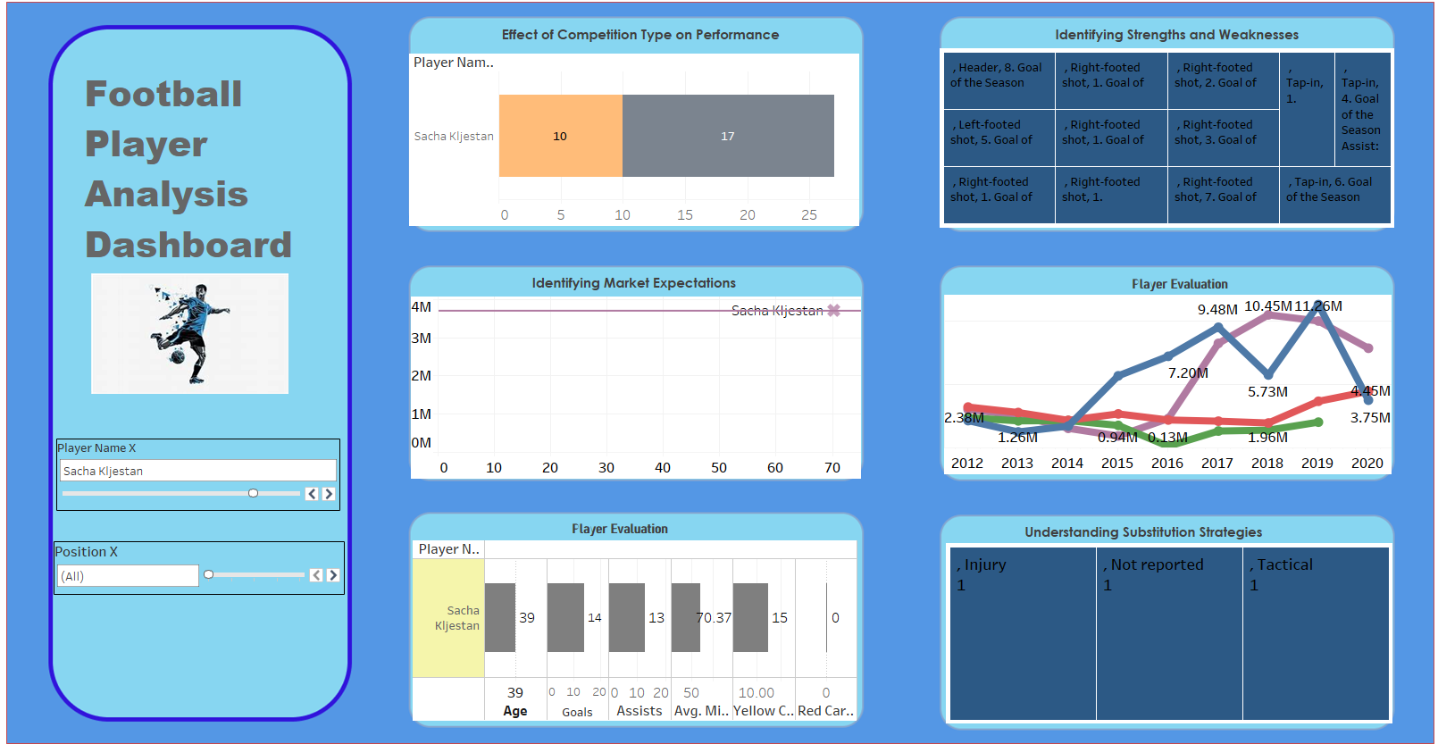
Player Analysis Dashboard

Slide 17
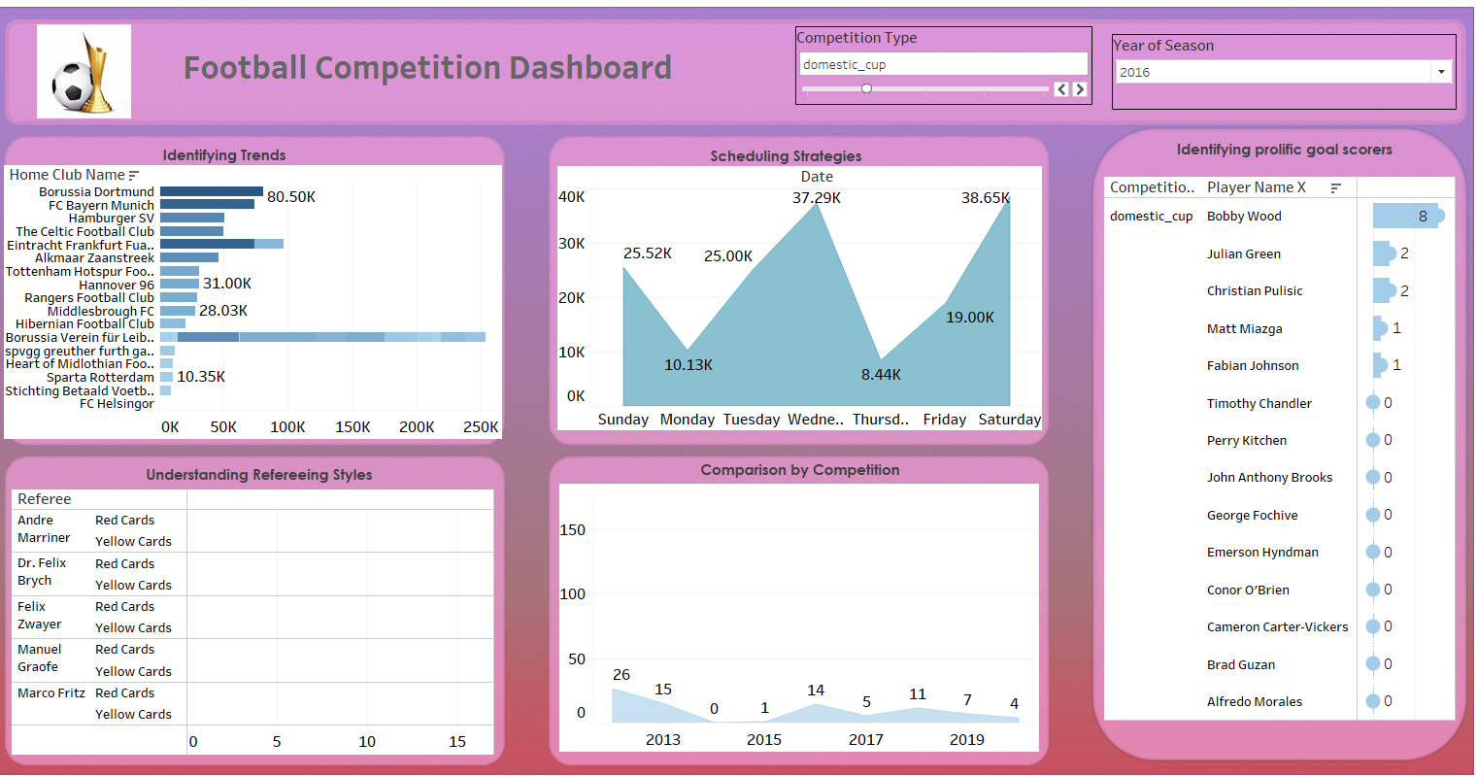
Competition Dashboard

Slide 18
Summary / Conclusion
Tactics and Strategy: Developing game plans that exploit weaknesses and maximize strengths.
Player Recruitment and Development: Identifying talented players and optimizing their training and development plans.
Contract Management: Negotiating fair and sustainable contracts.
Performance Optimization: Continuously improving individual and team performance.

Slide 19


